Slide 1
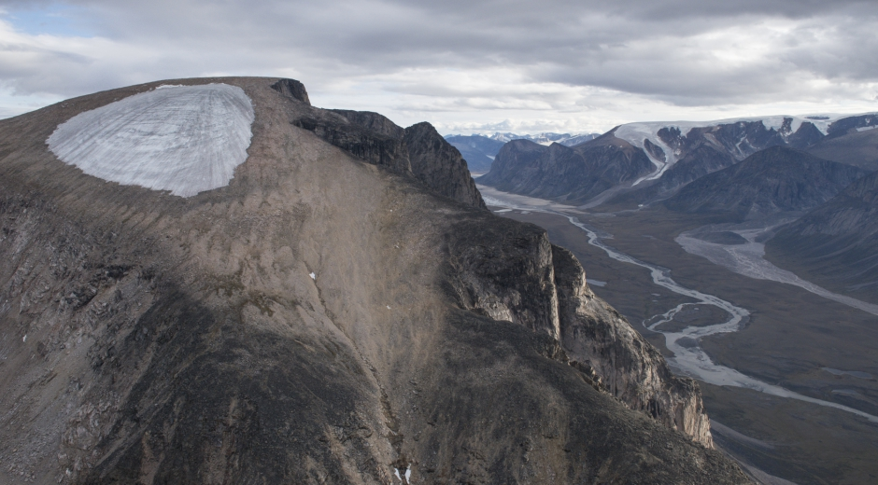
Determining the Timing and Rate of Laurentide Ice Sheet Thinning During the Last Deglaciation in New England with ¹⁰Be Dipsticks
Chris Halsted
Advisor: Dr. Jeremy Shakun
Image from: CU Boulder INSTAAR; Galleries; Baffin Island: Disappearing Ice and Climate Evidence

Slide 2
Ice Sheets
Atmospheric Composition
Ocean Circulation
Sea Level
Temperature
Background Method Expected Results
Notes:
How do these environmental variables interact? What are the feedbacks between them? Understanding the relationships at work here is essential for climate and sea level projections

Slide 3
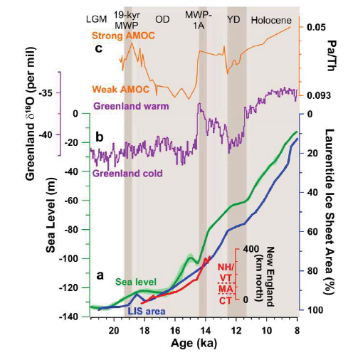
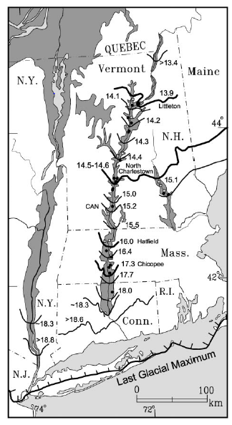


Paleo Reconstructions
>13.4
14.5-14.6
Figure from NSF proposal #1602280
>18.8
Figure modified from Ridge et al. (2012)
Background Method Expected Results
Notes:
One of the best ways to investigate the relationships between these environmental variables is with paleoclimate and paleo-ice sheet reconstructions. At this point, describe what is shown in the proxy stack and point out how AMOC and Greenland temp increase during MWP-1A, but there is a chicken and egg scenario where we struggle to say what caused what. Uncertainty in a reconstruction prevents more conclusive statements about the inter-variable relationships from being made. For instance, was MWP-1A sourced largely from the LIS? We currently cannot tell because of poor constraints on the LIS volume history. Mention here that I am focusing on reducing the uncertainty in one of the environmental variable records, ice volume of the LIS during its deglaciation

Slide 4
Research Objective:
Construct ¹⁰Be dipsticks using mountains throughout New England to constrain the timing and rate of ice thinning at these locations
Motivating Questions:
Did thinning occur predominately during the Oldest Dryas/Heinrich Stadial I cold period or during the Bølling-Allerød warm period?
Do the timing and rate of southeastern Laurentide thinning indicate that this ice mass contributed to MWP-1A?
  If not, did it respond to the abrupt warming after this event?
How accurately do current deglacial models depict ice thinning in New England?
Background Method Expected Results

Slide 5
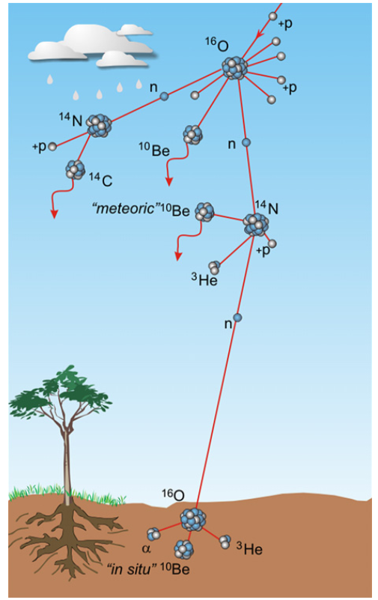

¹⁰Be Dipsticks: Concept and Creation
¹⁰Be concentration in quartz (atoms g⁻¹; N₁₀)
¹⁰Be production rate in quartz at the sample site (atoms g⁻¹ yr⁻¹; P₁₀)
¹⁰Be decay constant (yr⁻¹; λ₁₀)
4.99 x 10⁻⁷ yr⁻¹
From Balco (2011)
t = Amount of time that the surface has been exposed to cosmic rays!!
Figure from von Blanckenburg and Willenbring (2014)
Background Method Expected Results
Notes:
Mention that in-situ concentration decreases exponentially with depth, until about a meter or two below the surface there is virtually no production occurring

Slide 6
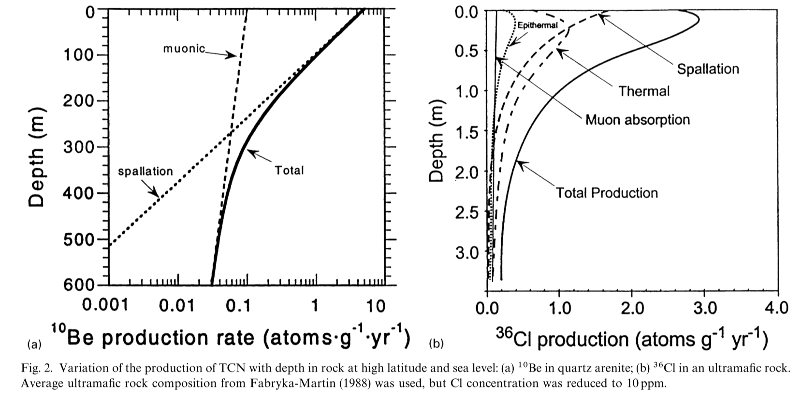
¹⁰Be Dipsticks: Concept and Creation
Depth (cm)
Figure from Gosse and Phillips (2001)
Figure from von Blanckenburg and Willenbring (2014)
Background Method Expected Results
Notes:
Mention that in-situ concentration decreases exponentially with depth, until about a meter or two below the surface there is virtually no production occuring

Slide 7
¹⁰Be Dipsticks: Concept and Creation
LGM
Deglaciation
Today
Background Method Expected Results

Slide 8
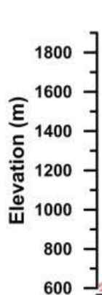
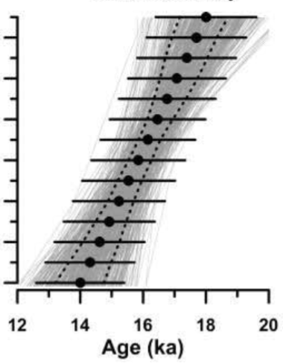
¹⁰Be Dipsticks: Concept and Creation
Modified from NSF proposal #1602280
Old
Young
Exposure Age
Background Method Expected Results

Slide 9
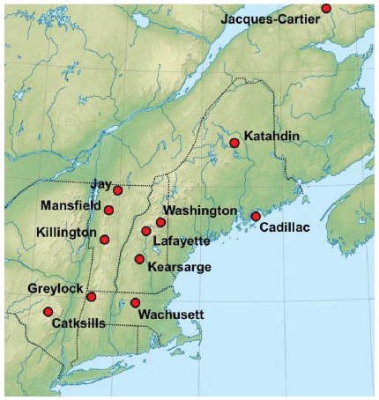
More Data = Better Histories
n = 10
Goal is to create dipsticks at locations shown to constrain the timing and rate of Laurentide thinning at each location
n = 12
Bigelow
n = 6
n = 9
n = 7
n = 15
n = 7
Monadnock
n = 8
n = 4
n = 6
Background Method Expected Results

Slide 10
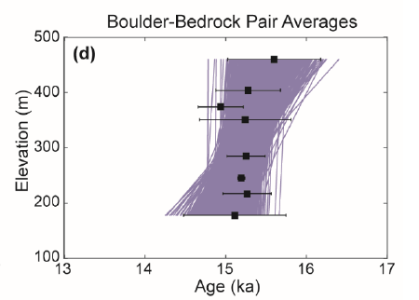
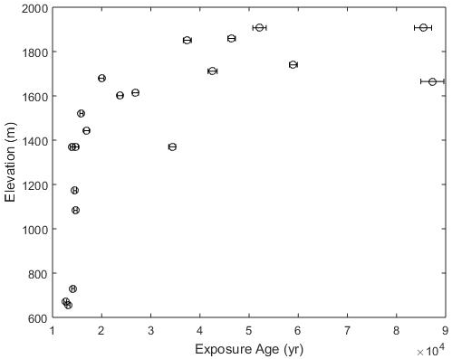
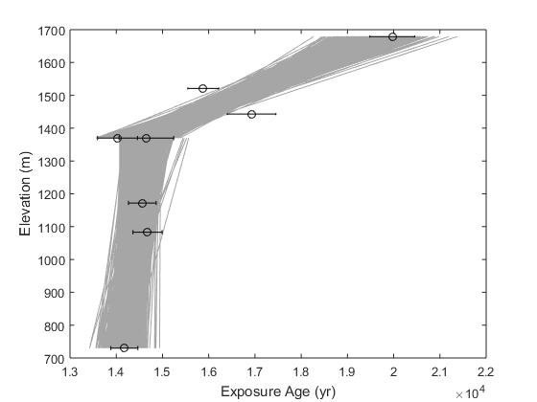
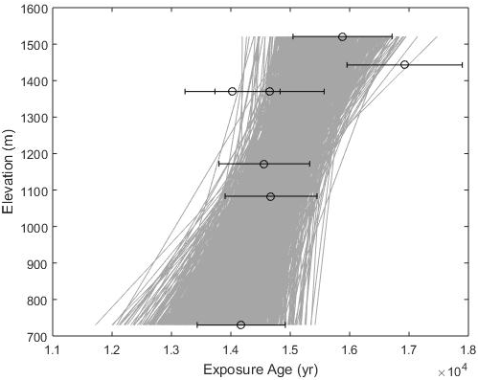
Existing New England Dipsticks:
Central Maine (Mt. Katahdin): Rapid thinning between 16-15 ka (Davis et al., 2015)
Coastal Maine (Acadia): Rapid thinning around 15.2 ± 0.7 ka (Koester et al., 2017a)
Mt. Washington, NH (Koester et al., 2017b): Difficult to fully assess
Background Method Expected Results

Slide 12
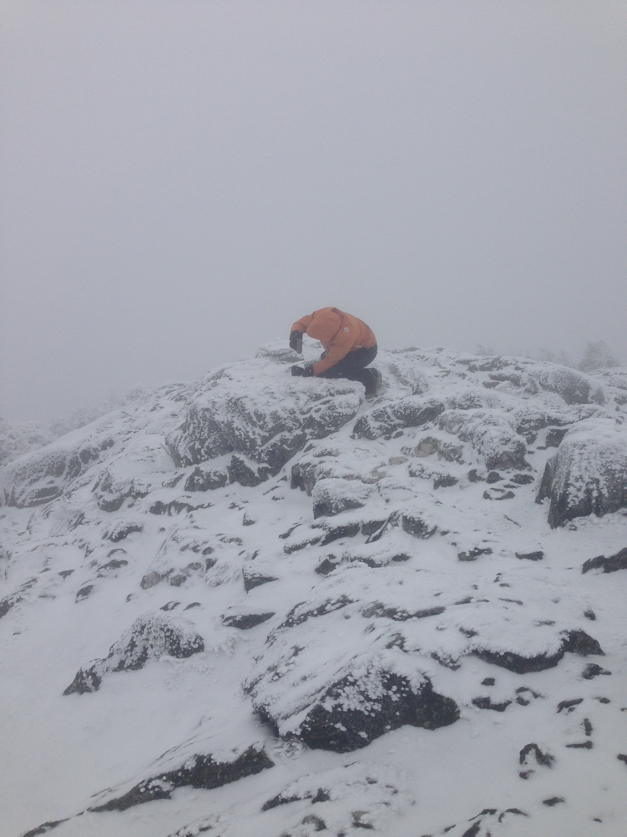
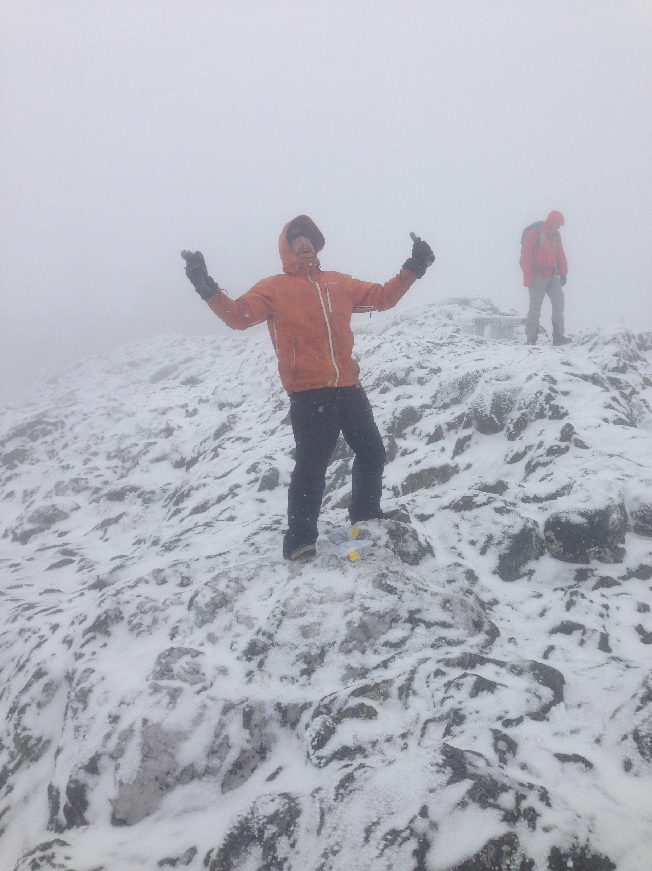
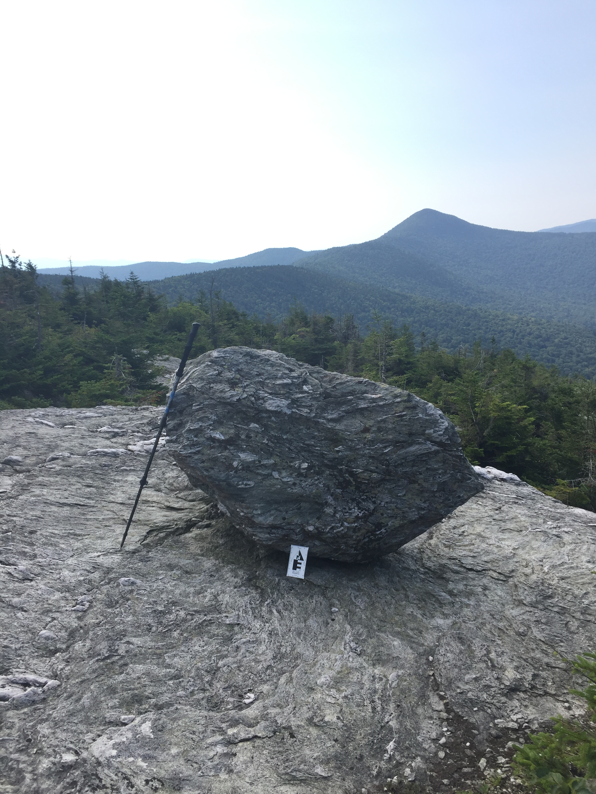
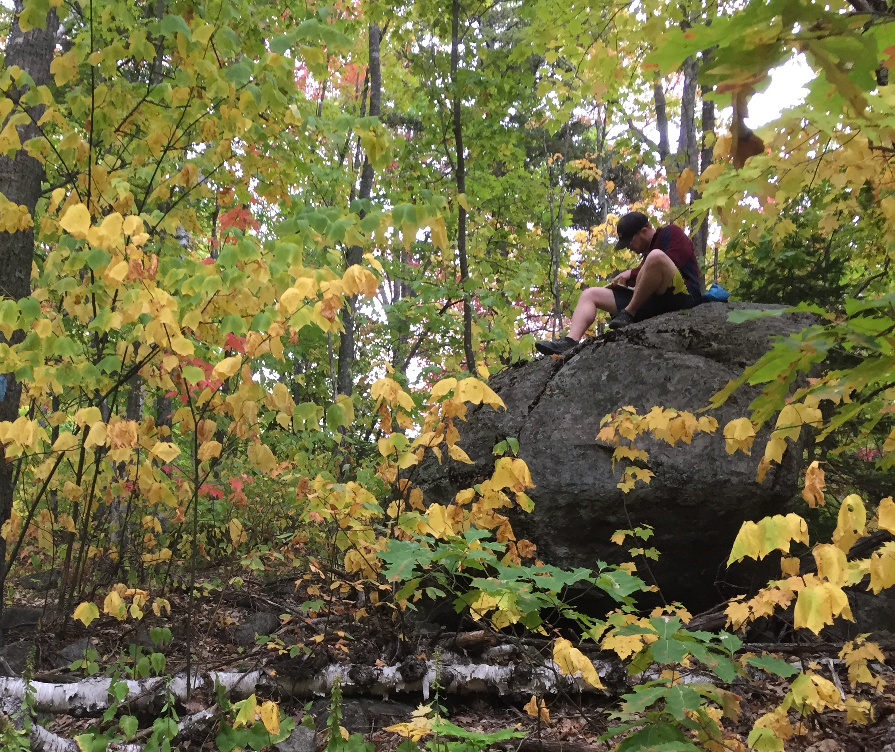
Field Photos!
Sampling in Northern VT in November…
Glacially-deposited boulders

Slide 13
References Cited
Davis, P.T., Bierman, P.R., Corbett, L.B., and Finkel, R.C., 2015, Cosmogenic exposure age evidence for rapid Laurentide deglaciation of the Katahdin area, west-central Maine, USA, 16 to 15 ka: Quaternary Science Reviews, v. 116, p. 95-105.
Dyke, A.S., and Gibbard, P.L., 2004, An outline of North American deglaciation with emphasis on central and northern Canada, Elsevier.
Gosse, J.C., and Phillips, F.M., 2001, Terrestrial in situ cosmogenic nuclides: theory and application: Quaternary Science Reviews, v. 20, no. 14, p. 1475-1560.
Koester, A.J., Shakun, J.D., Bierman, P.R., Davis, P.T., Corbett, L.B., Goehring, B.M., Vickers, A., Zimmerman, S.H., 2017a, Rapid thinning of the Laurentide ice sheet at Mt. Washington, NH, during the Bolling Warming, constrained by analysis of cosmogenic 14C and 10Be: Geological Society of America Abstracts with Programs, v. 49, no. 6.
Koester, A.J., Shakun, J.D., Bierman, P.R., and Davis, P., 2017b, Rapid thinning of the Laurentide Ice Sheet in coastal Maine, USA during late Heinrich Stadial 1: Quaternary Science Reviews, v. 163, p. 180-192.
Ridge, J.C., Balco, G., Bayless, R.L., et al., 2012, The new North American Varve Chronology: A precise record of southeastern Laurentide Ice Sheet deglaciation and climate, 18.2-12.5 kyr BP, and correlations with Greenland ice core records: American Journal of Science, v. 312, no. 7, p. 685-722.
von Blanckenburg, F., and Willenbring, J.K., 2014, Cosmogenic Nuclides: Dates and Rates of Earth-Surface Change: Elements, v. 10, no. 5, p. 341-346.

